Slide 1
Presentation on virtual assistant
Submitted by
Swati kushwaha
1833083003
MCA(leet)

Slide 2
ABOUT VIRTUAL ASSISTANT
Virtual Assistant is voice assistant
Virtual Assistant supports both text or voice entry and it will follow the conversation whichever entry method we're using.
Virtual Assistant offers voice commands, voice searching, and voice-activated device control, letting you complete a number of tasks after you've said the “Hello sir" or “Sure sir" wake words.
It is designed to give us conversational interactions.

Slide 3
ABOUT PYTHON
Python is a widely used general-purpose, high-level programming language.
Python allows programming in Object-Oriented and Procedural paradigms.
Python programs generally are smaller than other programming languages like Java. Programmers have to type relatively less and indentation requirement of the language, makes them readable all the time.
Python language is being used by almost all tech-giant companies like – Google, Amazon, Facebook, Instagram, Dropbox, Uber… etc

Slide 4
MODULES USED
Tkinter
Python provides the standard library Tkinter for creating the graphical user interface for desktop based applications.
Web browser
It is module that provides a high-level interface which allows displaying Web-based documents to users.
Speech recognition
Speech recognition is the process of converting spoken words to text
Play sound
The module snack sound kit can play several audio files: WAV, AU, AIFF, MP3, CSL, SD, SMP, and NIST/Sphere.
OpenCV
It makes use of Numpy, which is a highly optimized library for numerical operations with a MATLAB-style syntax
PIL
It is the Python Imaging Library which provides the python interpreter with ... PIL.

Slide 5
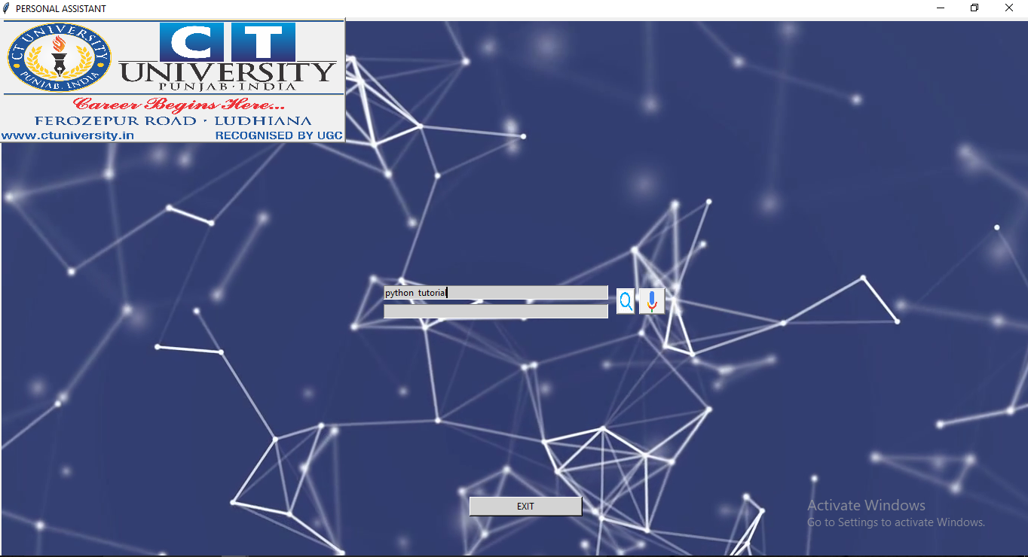
Virtual assistant window

Slide 6
Thank you

